Slide 1
Hernan Cortez and the Conquest of Mexico

Slide 2
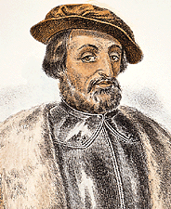
Hernan Cortez
Spanish Explorer captured capital Tenochtitlan (Mexico City).
He would go on to capture the dominating Aztec people.
Today the Mexican culture is a blend of native and Spanish traditions and cultures

Slide 3
How He took Control of The Mayan And Aztec People
He rescued a Spaniard enslaved by the Mayans
He captured Malinche a female Indian slave who knew Mayan and Nahatl (Aztec langauge)
He has superior fire power and horses
Used other Indians taken by Aztecs to fight.

Slide 4
Conquering Tenochtitlan
Aztec leader (Moctezuma) thought Cortez was Quetzalcoatl, a god, who would return to his people in Aztec legend
This allowed Cortez to approach the city unopposed
The Spanish soldiers were amazed at the site of the city
300,000 people lived in just ten square miles

Slide 5
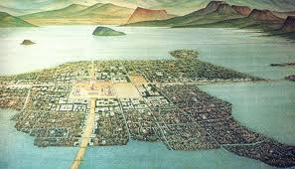
Tenochtitlan

Slide 6
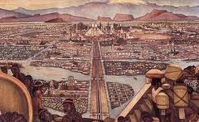
Tenochtitlan

Slide 7
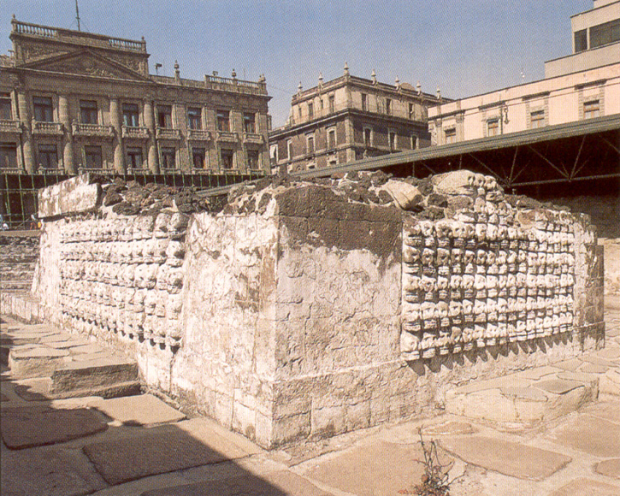

Slide 8
Hunger for Gold
Spanish wanted riches from Aztec people and had a hard time hiding it.
Aztec attack and drive Cortez out of the City June 30, 1520
Cortez mounts a counter attack a year later August 13, 1521 and takes over city.
Small Pox epidemic wipes out many Aztecs.
Spain Rules Mexico for next three centuries
Native Population 20 mil 2mil.

Slide 9
Long Term Results of Spanish Rule in Mexico
New Crops were introduced
The use of Horses spread as far as the American Plains
Language and Customs
New race of people (Mestizos) created from Spanish and native intermarriages
Universities were created
Catholic religion

Slide 10
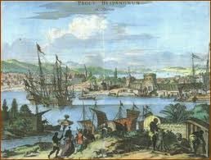
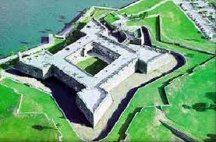
Spanish rule in America
The English and French threatened Spanish rule in America
To protect their interests the Spanish created a fort at St. Augustine in 1565.
First European Settlement in future U.S

Slide 11
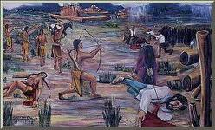
Read Pages 21-22 to answer the following:
What Spanish Explorer led the expedition against the Pueblo people?
At the battle of Acoma what did they do to survivors of the Pueblo?
What did they name their settlement? What was the capital?
What was the main objective of the new settlement?
The picture to the right
depicts Pope’s rebellion, what
was Pope’ s rebellion?

Slide 12
Read pages 22-23 to answer the following:
Where did Spain set up a mission in Texas in the early 1700s?
What would this later become?
Who led the founding of a mission in San Diego?
How many missions were founded on the coast of California?
What did the Franciscan Friars teach the “misson Indians”?

